Slide 1
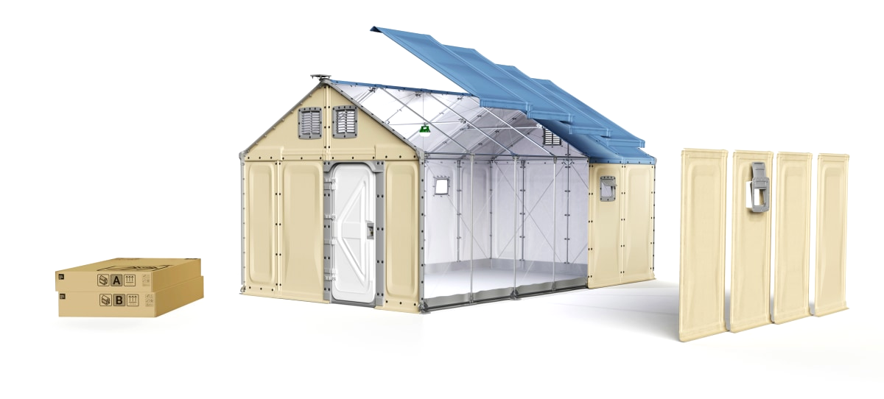
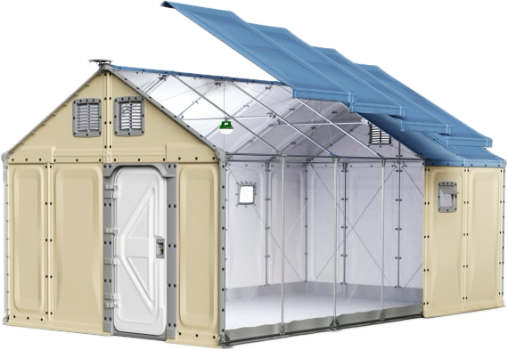
Daylight-Informed Exploration of Window Configurations in
Modular Temporary Shelters
Using Machine Learning
La’O, Bernadette 3035957329

Slide 2
Introduction
01
Methodology and Implementation
TABLE OF CONTENTS
02
Results and Discussion
03
Context, motivation, related works, problem, objective, scope
Key concepts, setup, workflow, data collection, machine learning
Model performance, data visualization, analysis, reflection

Slide 3
Introduction
01
Methodology and Implementation
02
Results and Discussion
03
Context, motivation, related works, problem, objective, scope
Key concepts, setup, workflow, data collection, machine learning
Model performance, data visualization, analysis, reflection

Slide 4


110 MILLION DISPLACED BY 2023
IRC (2023)

Slide 5
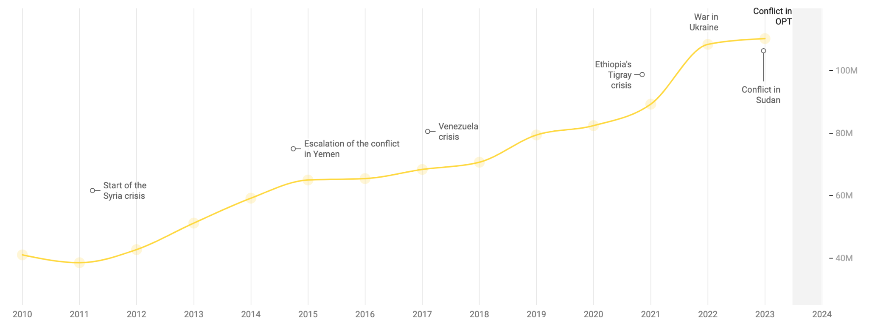
UNHCR (2023)
Highest number since 2000
1 in 124 people forcibly displaced
1 in 73 people forcibly displaced

Slide 6
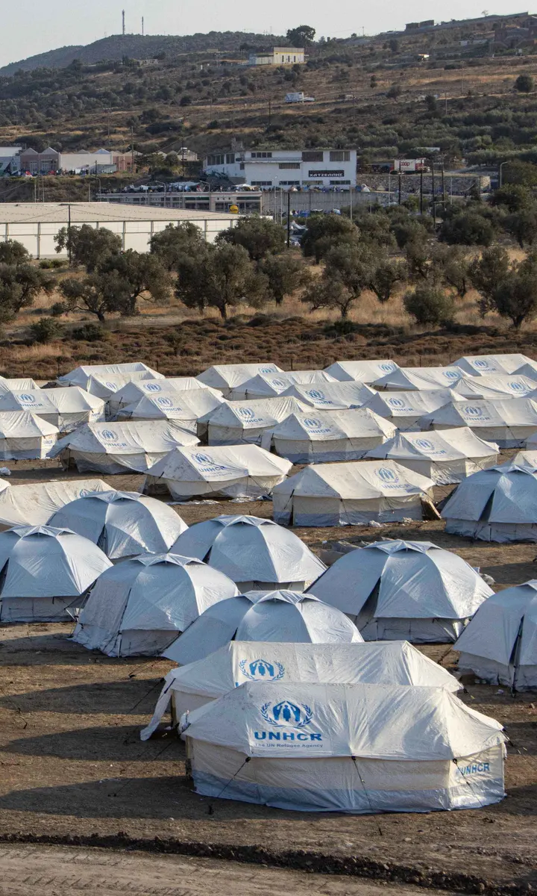
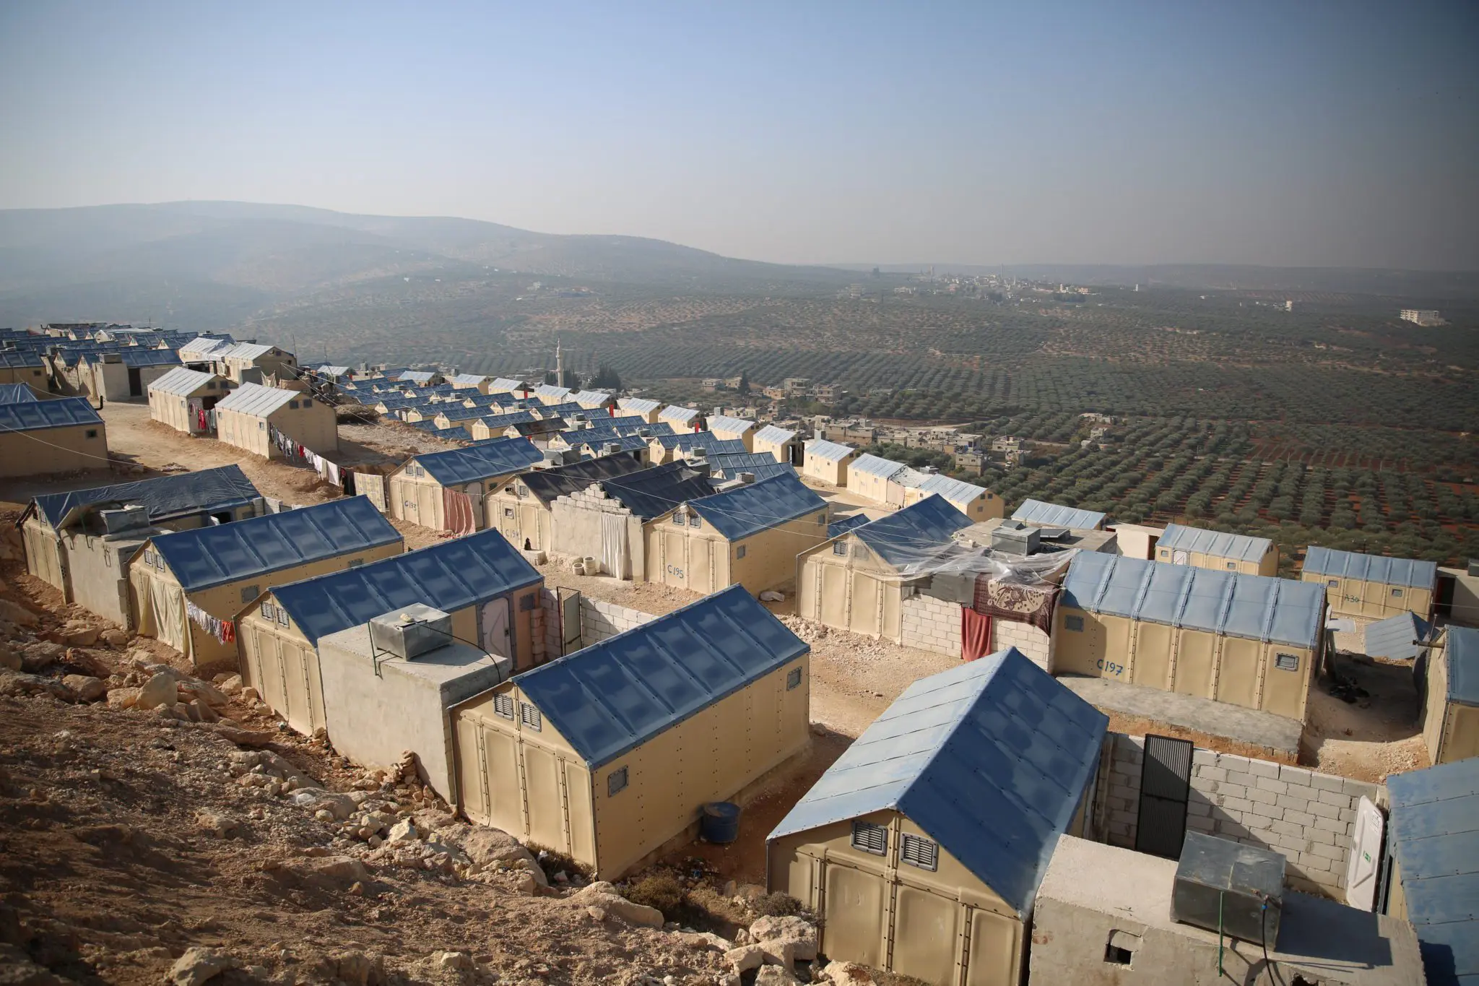
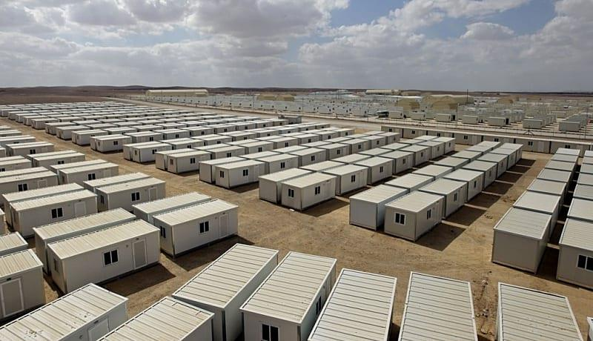
Mass deployed temporary shelters
Tents
Panels
Ex-containers
Laylin (2014)

Slide 7

Relief Housing Unit (RHU)
Long-term and modular
190,000 deployed since 2015
IKEA x UNHCR
Better Shelter (2013)
Cerini (2023)
Peters (2021)
Snow (2013)

Slide 8
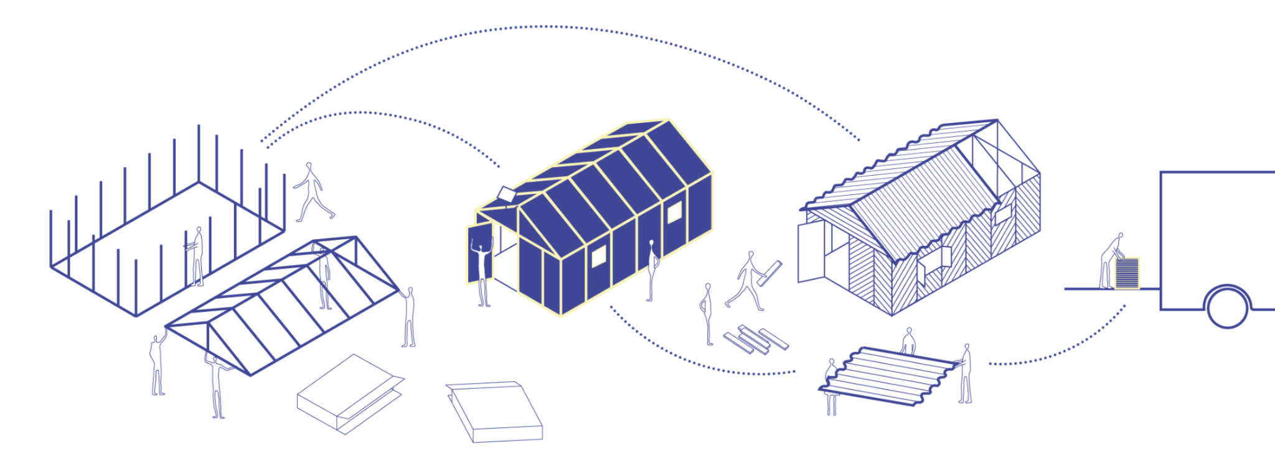
Better Shelter (2013)
Szondy (2013)
Wainwright (2017)
Johnson (2015)
EASY
UPGRADEABLE
To assemble with no tools and little labor
With local materials into a permanent home
FAST
EXPANDABLE
REUSABLE
Mass production and deployment
For clinics, classrooms, etc.
For future emergencies

Slide 9

PROBLEM
Criticized for not meeting indoor daylight needs
Dunn (2015)
Fairs (2017)
Scott-Smith (2017)
Jahre et al. (2018)

Slide 10
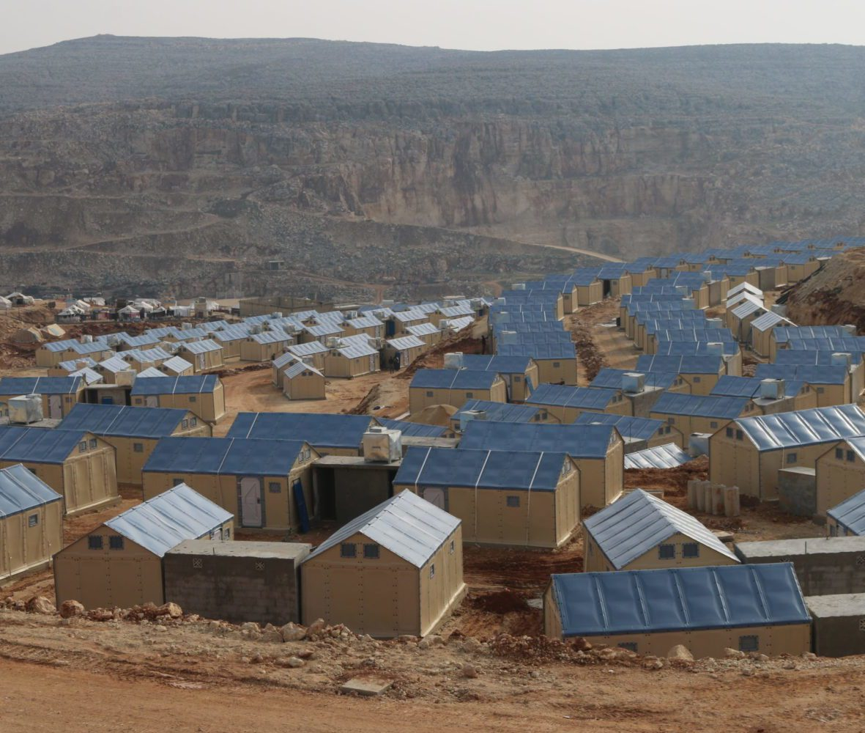
PROBLEM
Uniform assembly in camps despite interchangeable panels and different unit orientations

Slide 11
PROBLEM
Uniform assembly in camps despite interchangeable panels and different unit orientations

Slide 12
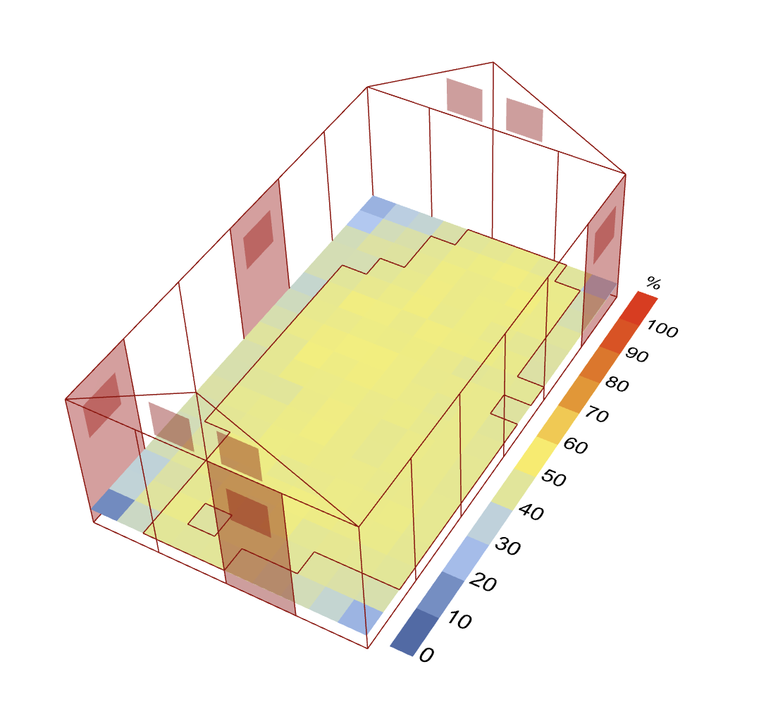
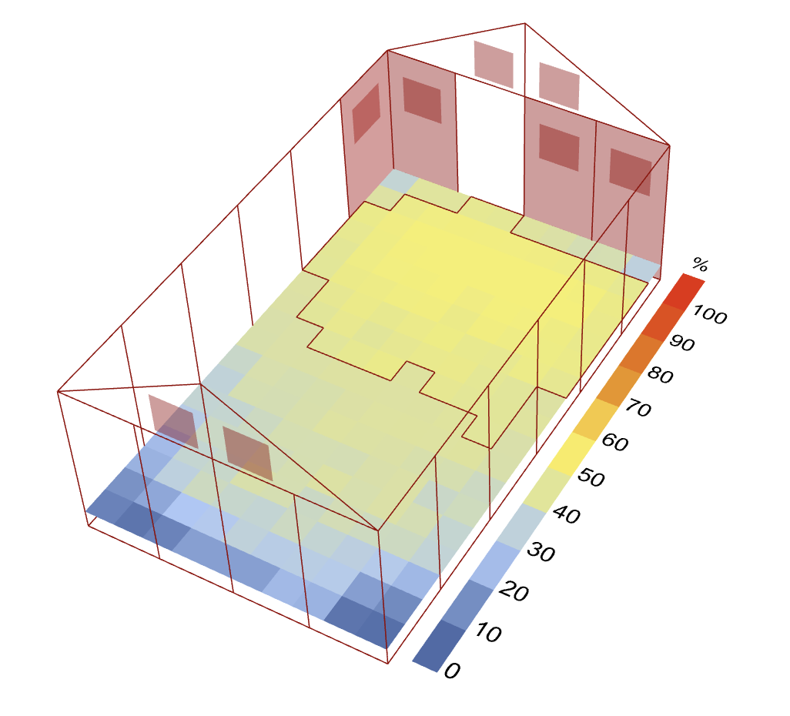
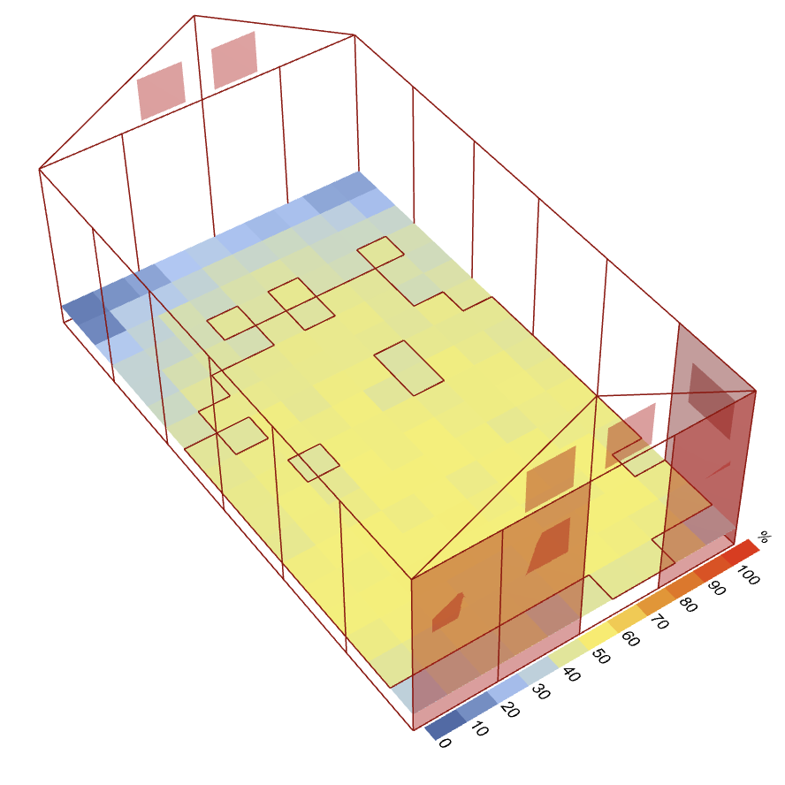
PROBLEM
Window configuration and orientation can affect annual daylight significantly…
76%
Different window configuration
42%
Different orientation
65%
of total area
of total area
of total area

Slide 13

PROBLEM
…but iterative daylight analysis can take DAYS to compute!

Slide 14
Objective
Use machine learning to explore the RHU’s modular design, develop daylight insights, and improve analysis tools

Slide 15
Scope
Setup daylight analysis and RHU model
Collect and visualize initial data
Run surrogate model to simulate instantaneous results
Run generative model to predict good window configurations

Slide 16
Introduction
01
Methodology and Implementation
02
Results and Discussion
03
Context, motivation, related works, problem, objective, scope
Key concepts, setup, workflow, data collection, machine learning
Model performance, data visualization, analysis, reflection

Slide 17
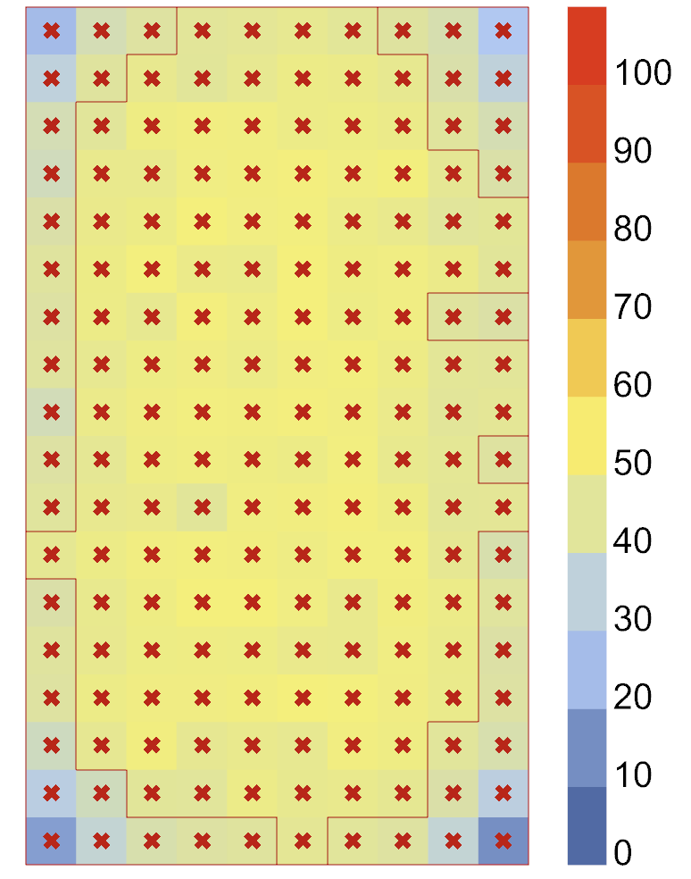




Daylight Autonomy (DA)
Floor area of the RHU
DA %
% of Total Area =
72%
% of time when a threshold of illumination is reached
Annual (9am-5pm each day)
Illumination measured by lux
Munoz et al. (2014)

Slide 18
Daylight Autonomy (DA)
Floor area of the RHU
DA %
% of Total Area =
72%
All 180 sensors have their own DA value

Slide 19
Daylight Autonomy (DA)
Floor area of the RHU
DA %
% of Total Area =
72%
Outlined sensors have a DA value larger than 40%
Represented by % of total area

Slide 20
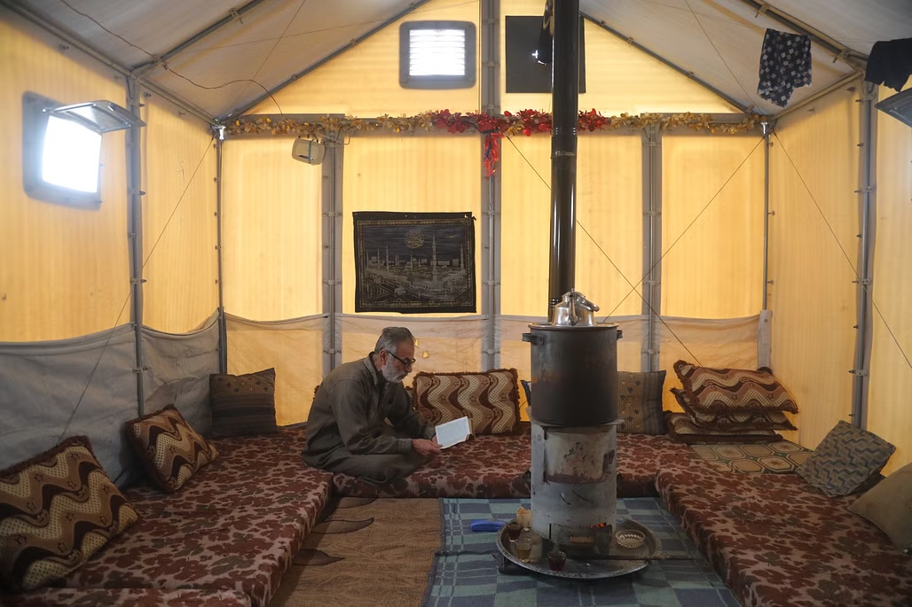


Home
SETUP
Lux threshold:
>150 lux
Location:
Syria
Unit geometry: Standard kit
Design variable #1: Window configuration
Design variable #2: Orientation
Classroom
Clinic
>150 lux
Day-to-day living
>300 lux
Basic reading and writing
>500 lux
General treatment
Kumar (2023)

Slide 21
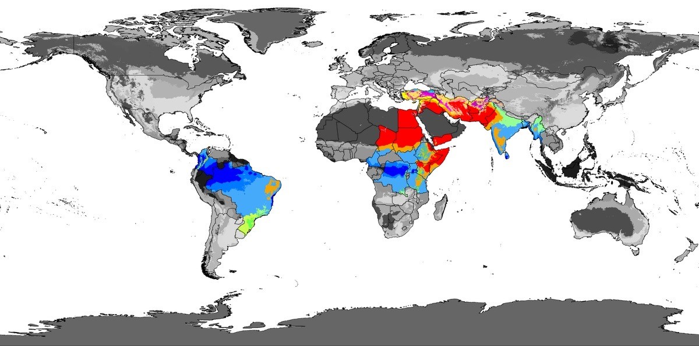
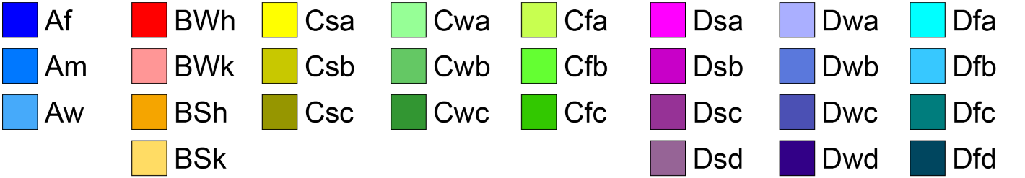
SETUP
Lux threshold:
>150 lux
Location:
Syria
Unit geometry: Standard kit
Design variable #1: Window configuration
Design variable #2: Orientation
Köppen climate zones of countries with the most populated refugee camps
Zones <30° from the equator can have as much as 60% difference in daylight performance
Terne (2022)
Köppen (1936)
Dyvik (2023)
Munoz et al. (2014)

Slide 22
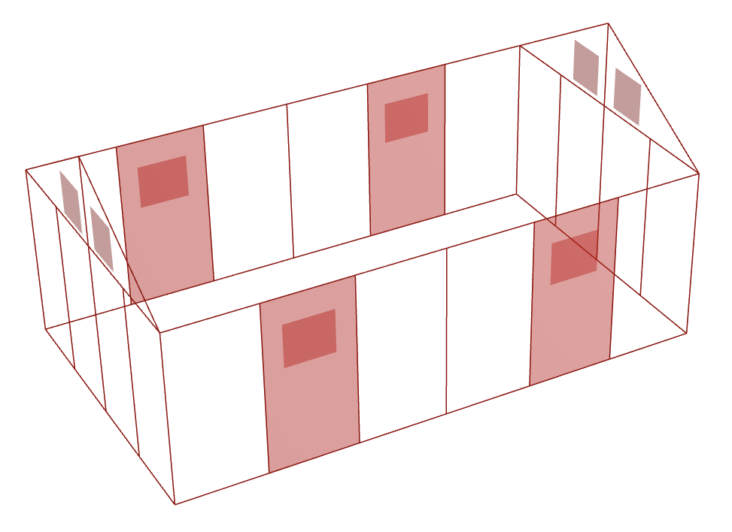
SETUP
Lux threshold:
>150 lux
Location:
Syria
Unit geometry: Standard kit
Design variable #1: Window configuration
Design variable #2: Orientation
Standard kit
Assume high windows for ventilation
x2
x2
x4
x71
x27
x1
Assume closed door for security and privacy
Brownell (2020)
Housing Innovation Collaborative (2023)

Slide 23
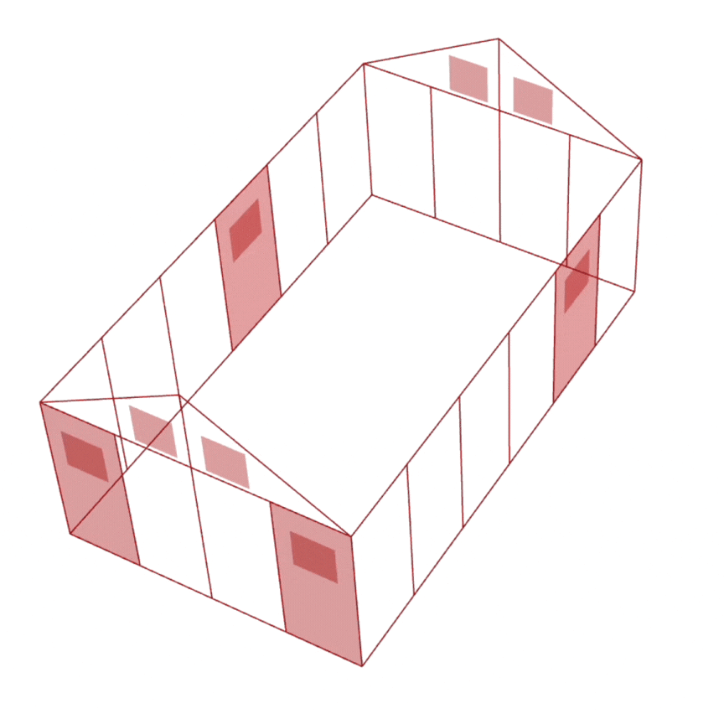
SETUP
Lux threshold:
>150 lux
Location:
Syria
Unit geometry: Standard kit
Design variable #1: Window configuration
Design variable #2: Orientation
Kaminska (2020)

Slide 24
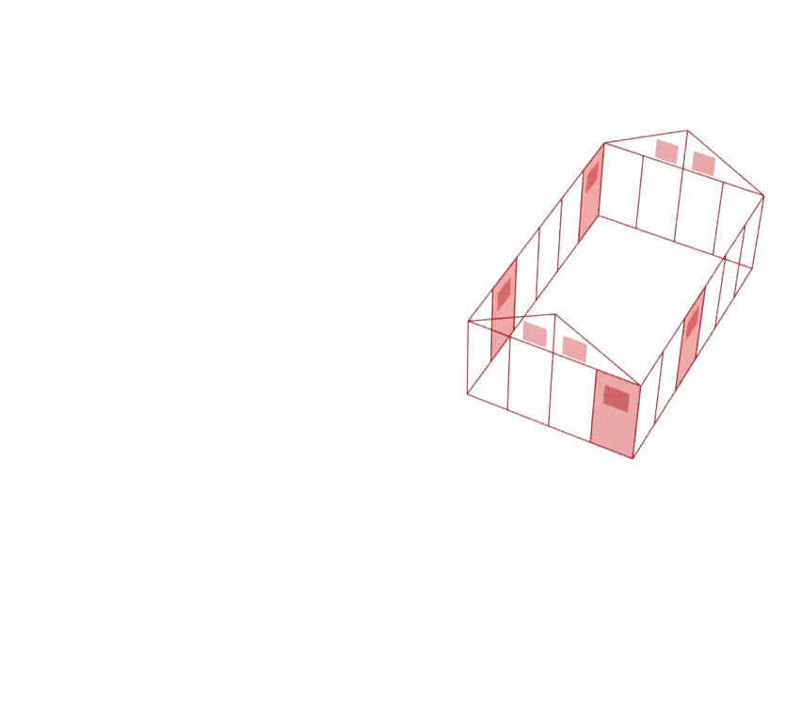
SETUP
Lux threshold:
>150 lux
Location:
Syria
Unit geometry: Standard kit
Design variable #1: Window configuration
Design variable #2: Orientation
Zomorodian et al. (2016)

Slide 25
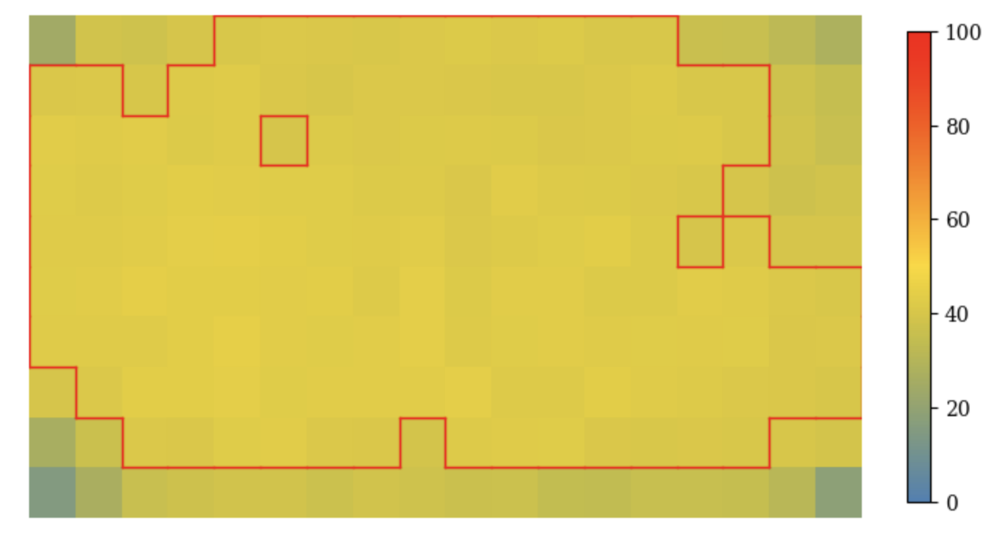
Workflow:
Data collection
Panel binaries
n = 4
0 | 1 | 2 |  | 4 | 5 | 6 | 7 | 8 | 9 | 10 |  | 12 | 13 | 14 |  | 16 | 17 | 18
West
0 | 1 | 2 |  | 4 | 5
18
17
16
6
7
8
9
Window
South
North
Window
 | 14 | 13 | 12 |  | 10
East

Slide 26
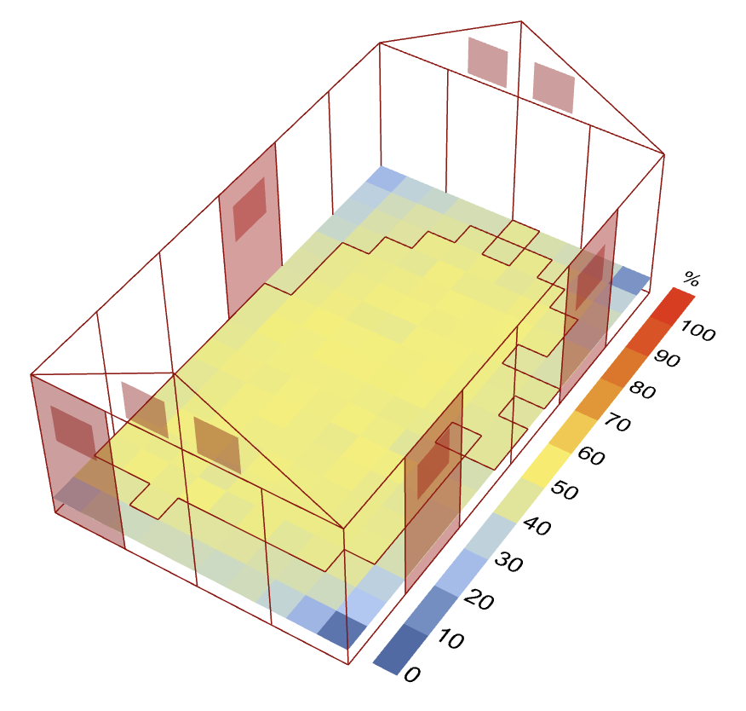
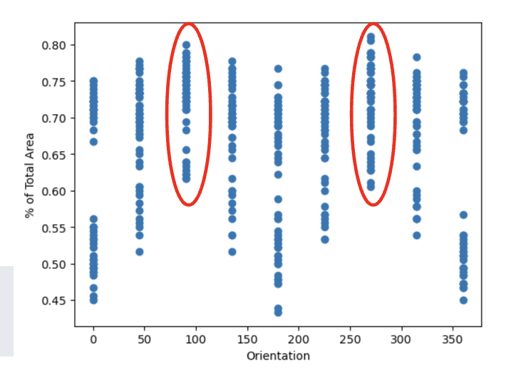

Workflow:
Data collection
2. Orientation
North
To track direction of windows in 15 degree rotation intervals from 0-180°
West
East
0°
South

Slide 27
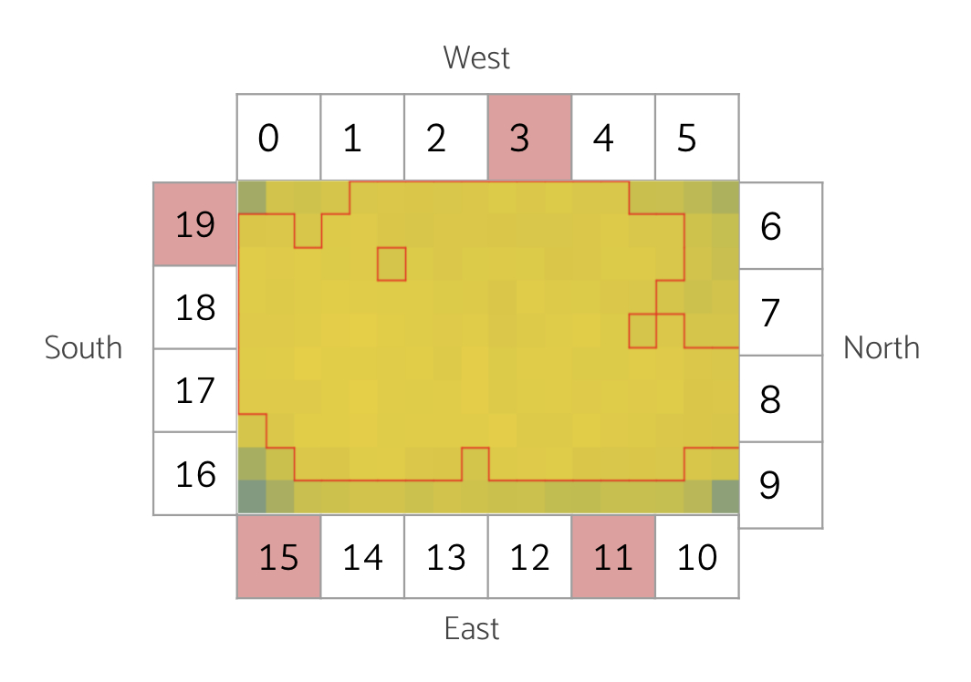
Workflow:
Data collection
3. Individual sensors
4. % of total area
5. Average sensor
To simulate DA values
To assess DA maximization
To account for dark corners/even distribution

Slide 28

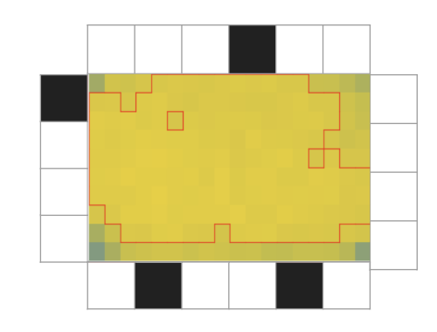
Workflow: ML Models
Generative
M
DA data
Surrogate
M
Good window configurations
Instantaneous predictions

Slide 29
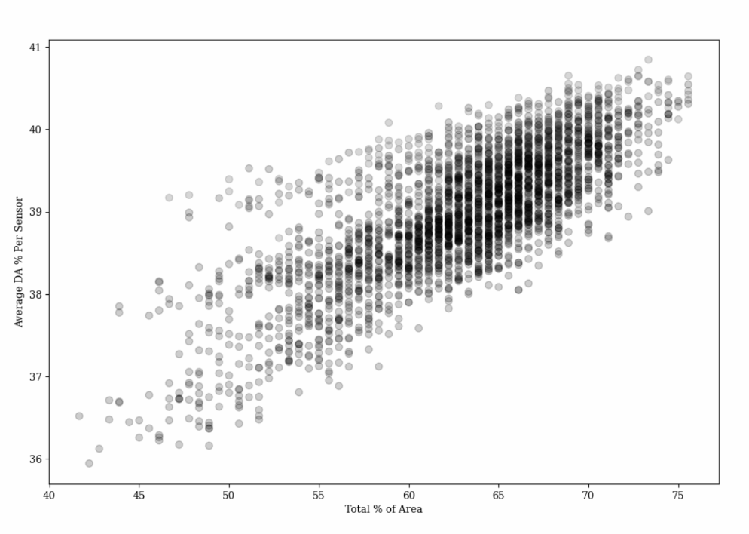
3000 window configurations (orientation control: 0°)
Workflow: ML Models
Train generative model with best performing only
Train surrogate model
Test surrogate model

Slide 30
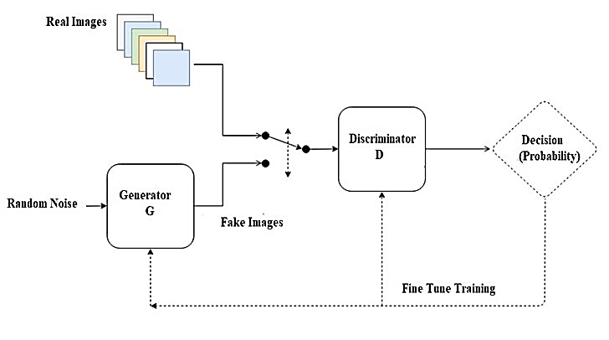

Workflow: ML Models
Convolutional neural network
Surrogate model (regression)
Generative model
Phung & Rhee (2019)
Goyal (2020)

Slide 31
Introduction
01
Methodology and Implementation
02
Results and Discussion
03
Context, motivation, related works, problem, objective, scope
Key concepts, setup, workflow, data collection, machine learning
Model performance, data visualization, analysis, reflection

Slide 32
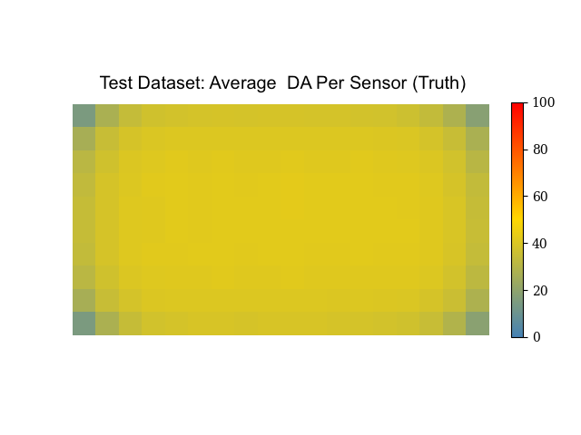

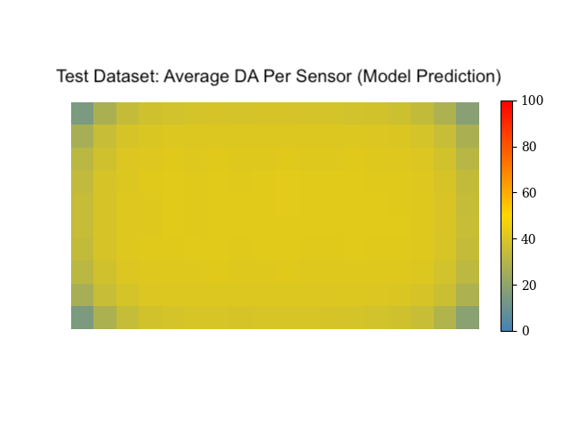
Absolute error between truth and prediction
Minimal average error per sensor!
Prediction is very similar to test data!

Slide 33
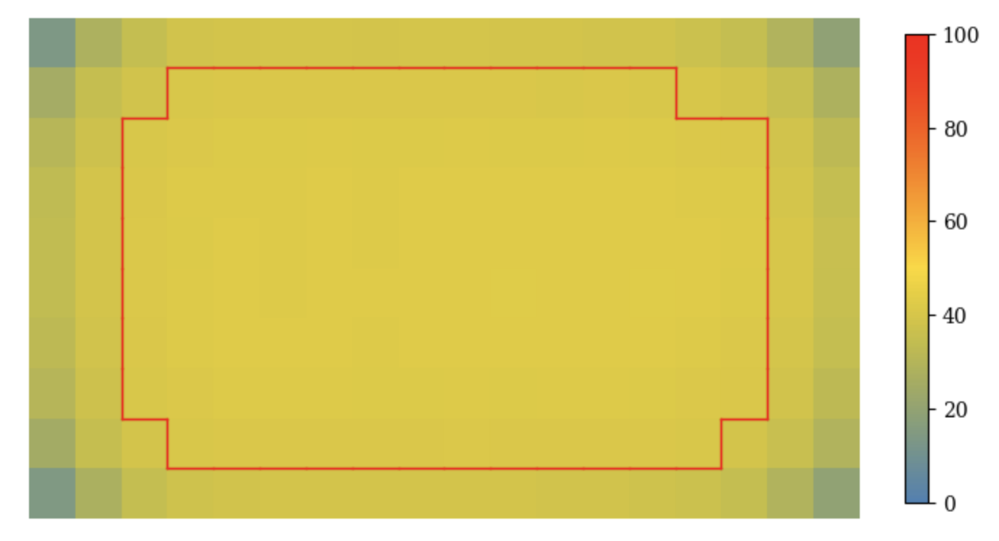
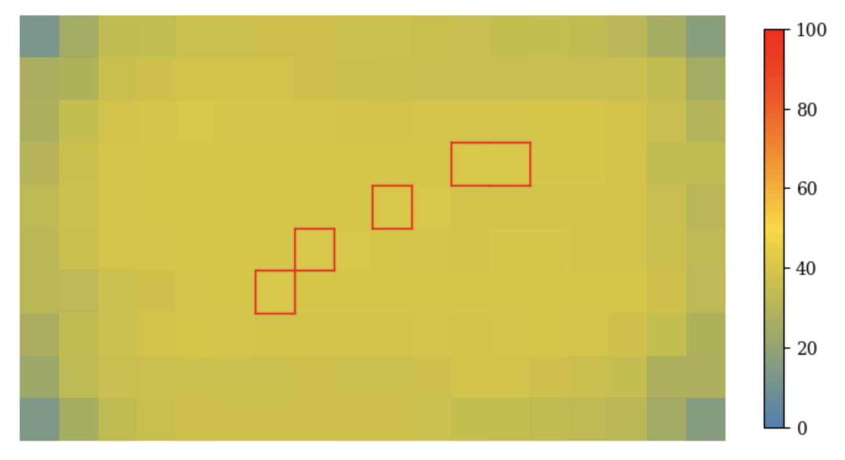
Average truth
Average prediction
…but small errors can interfere with threshold selection

Slide 34
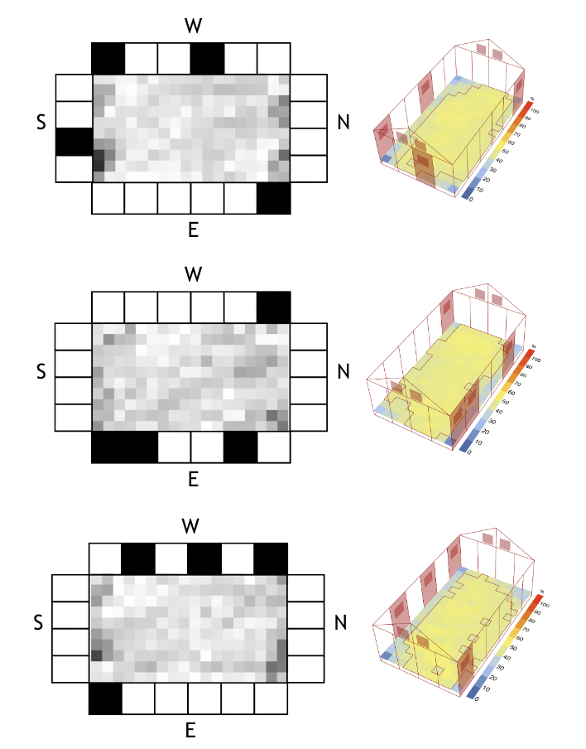
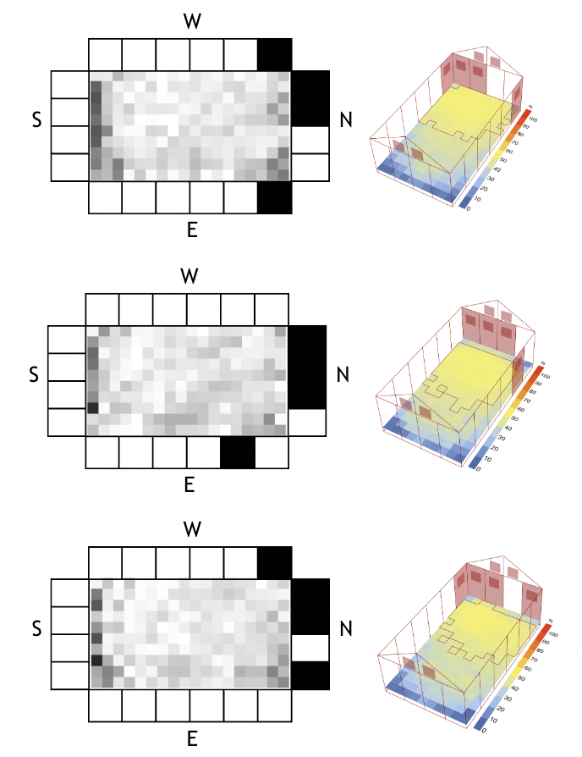
Most DA
Least DA
Higher error with less DA = harder to predict
Most error found around edges of the room

Slide 35
*normalized
Frequency of Each Window Panel
Most DA
West | North | East | South
Highest average sensor
Corner window panels versatile?
Least DA
Lowest average sensor

Slide 36
Window configurations with most DA
Window configurations with least DA
West | North | East | South
West | North | East | South
North-facing windows have significant effect
Spacing is important
but…

Slide 37
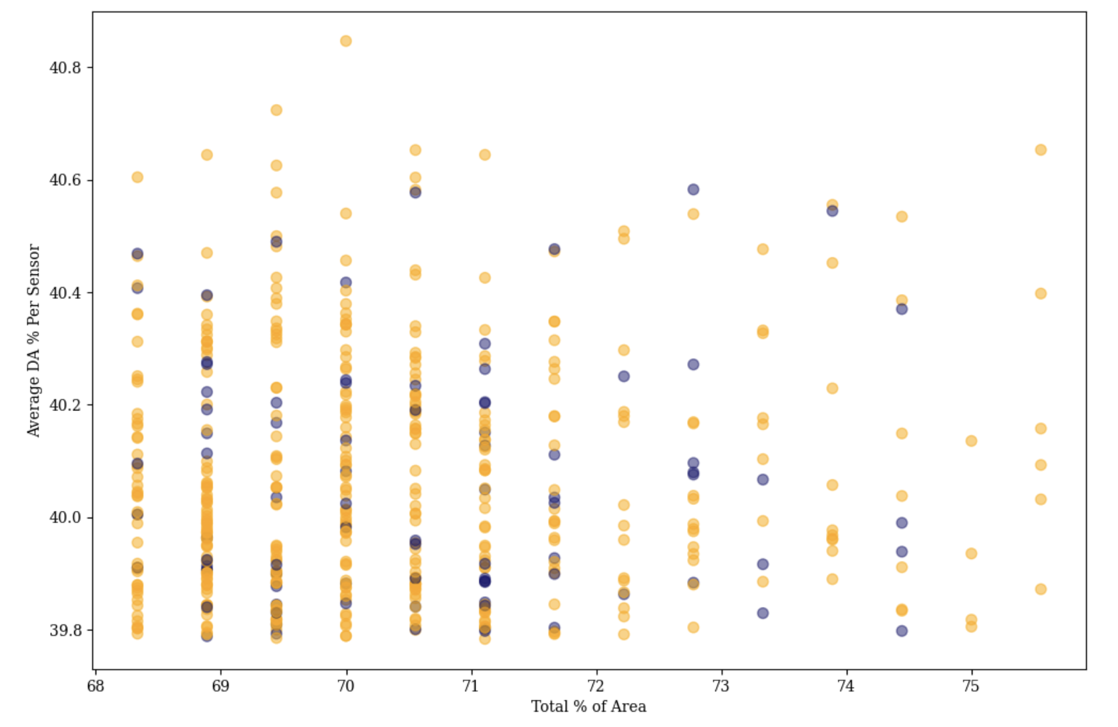
Window configurations with most DA
83%
With consecutive windows
17%
Without consecutive windows
…majority have consecutive windows

Slide 38
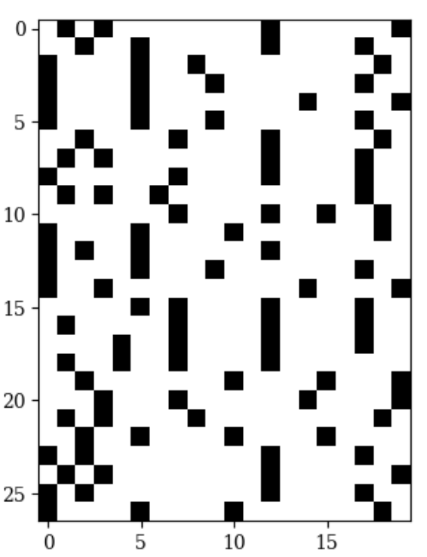
75th percentile (>67%)
29%
Above average (>62%)
43%
Underperformed
28%
Performance of generated window configurations
West | North | East | South
Generated no consecutive windows and lots of north/south facing windows…

Slide 39
Improved! Gets good results 30x faster!

Slide 40
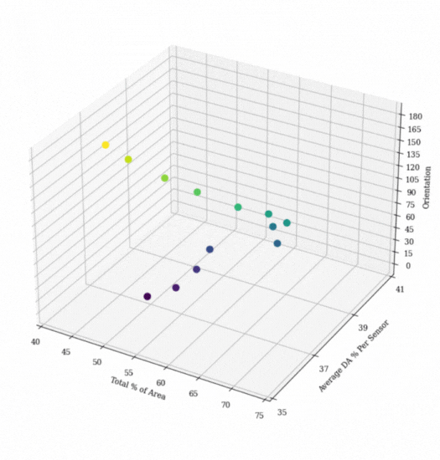
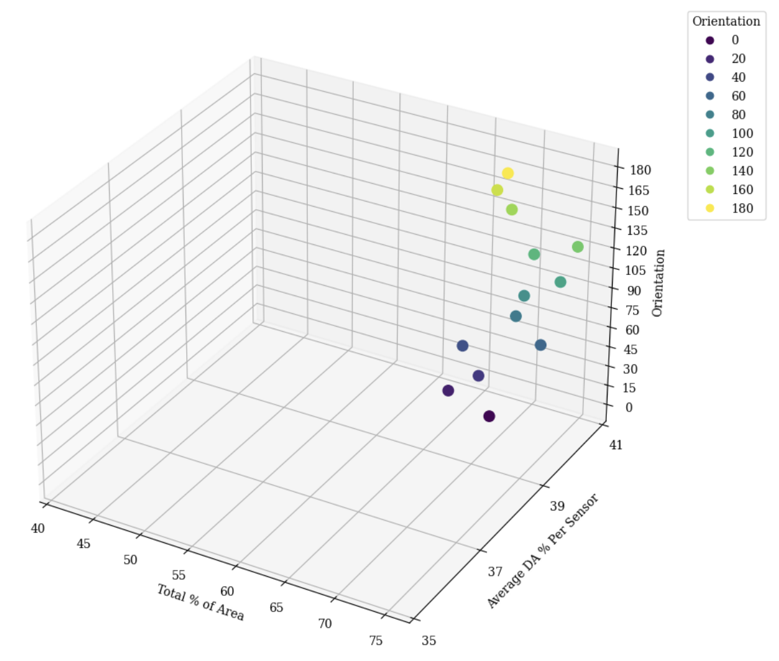
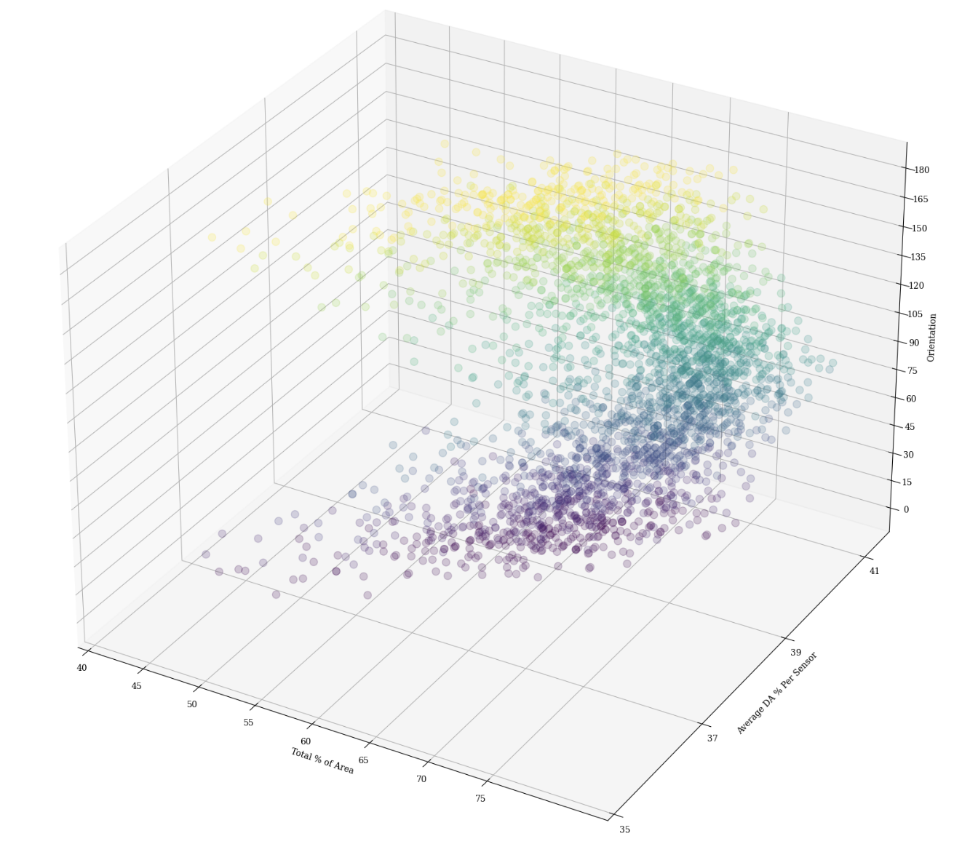
90° allows for further reach

Slide 41
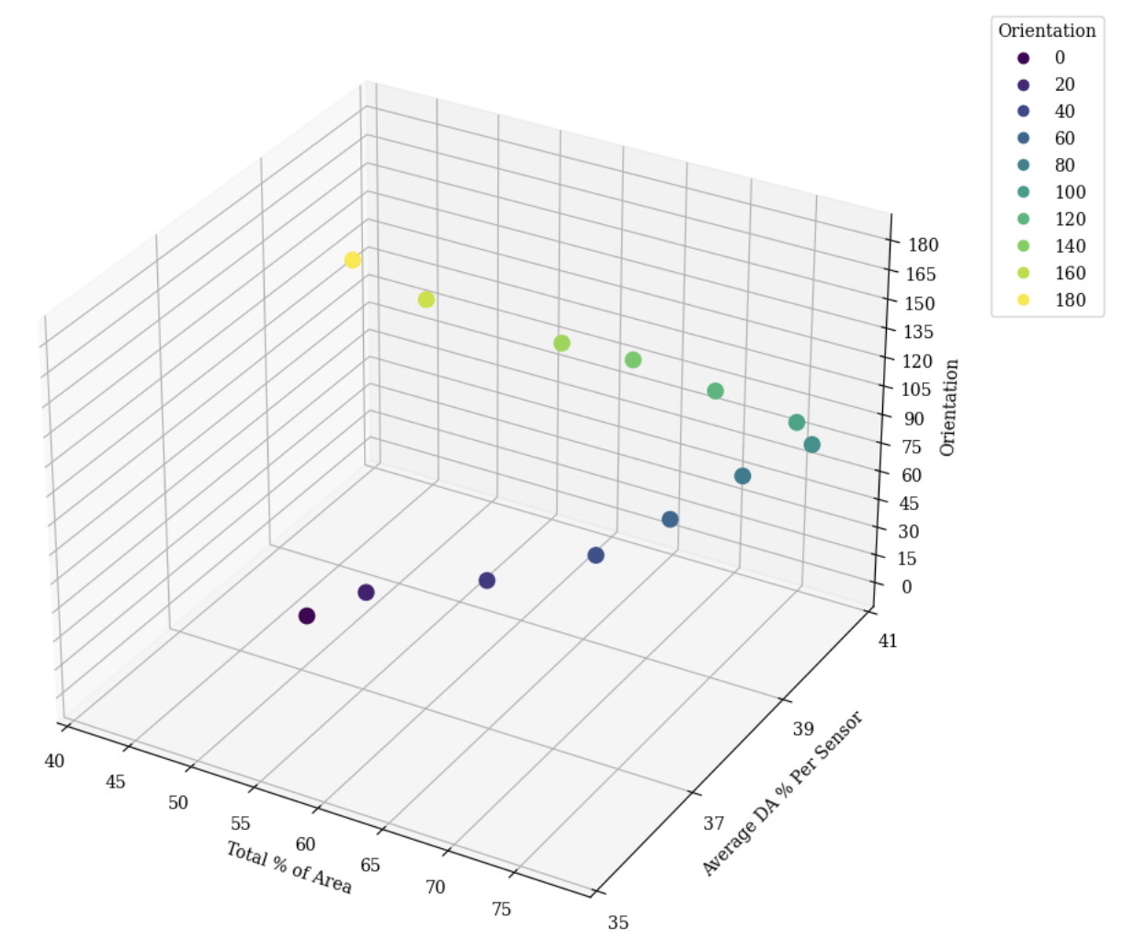
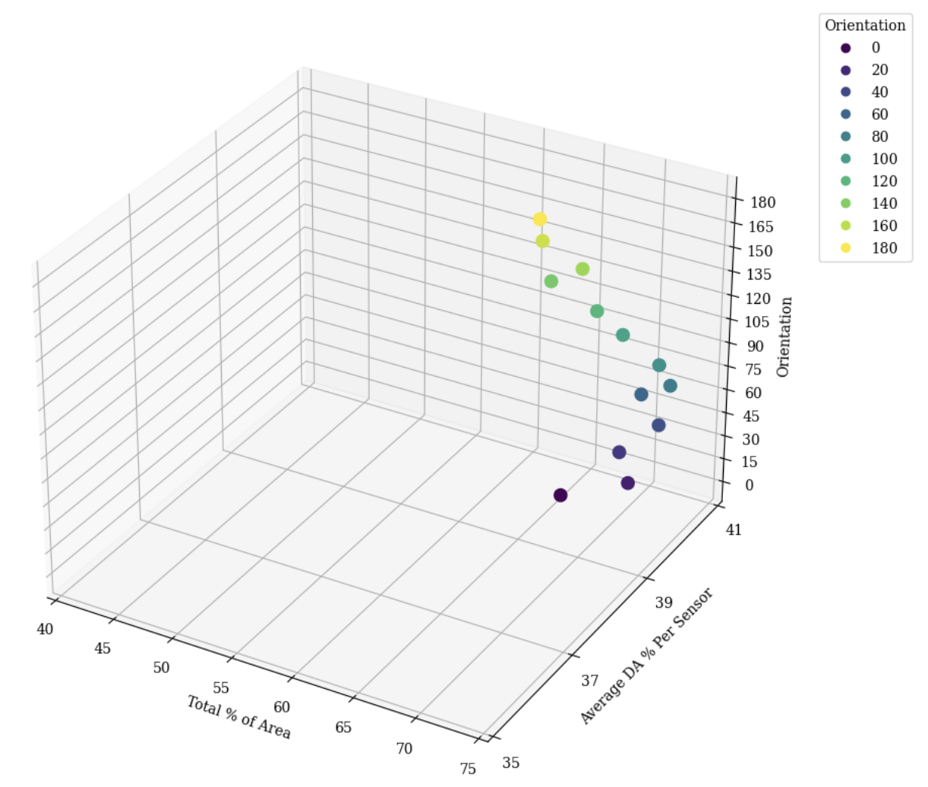
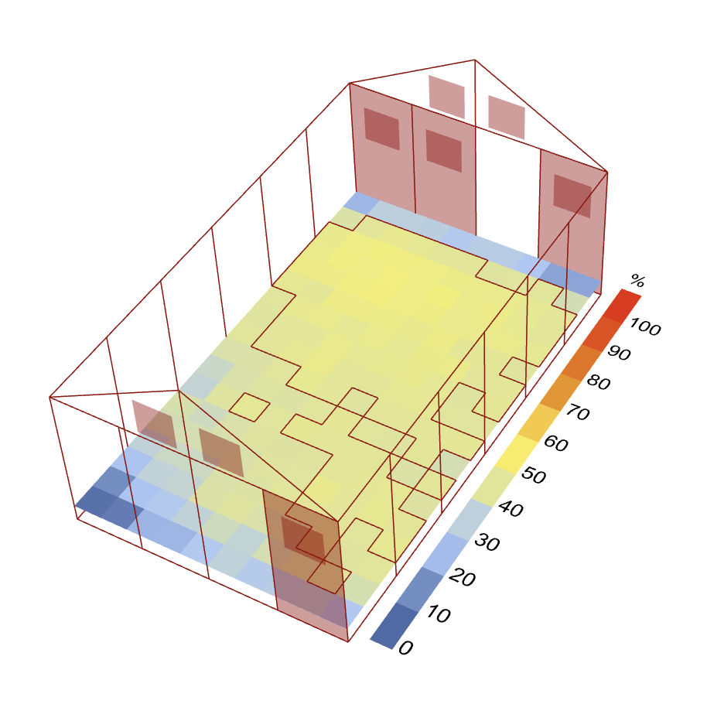
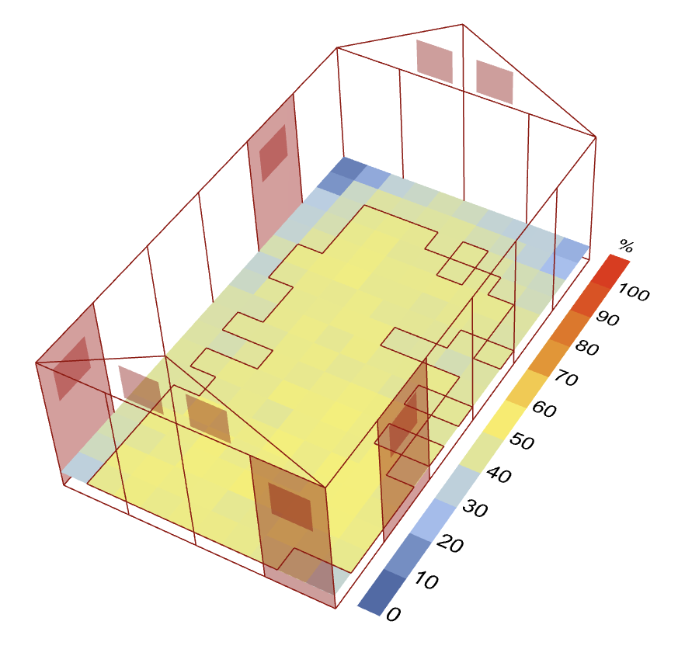
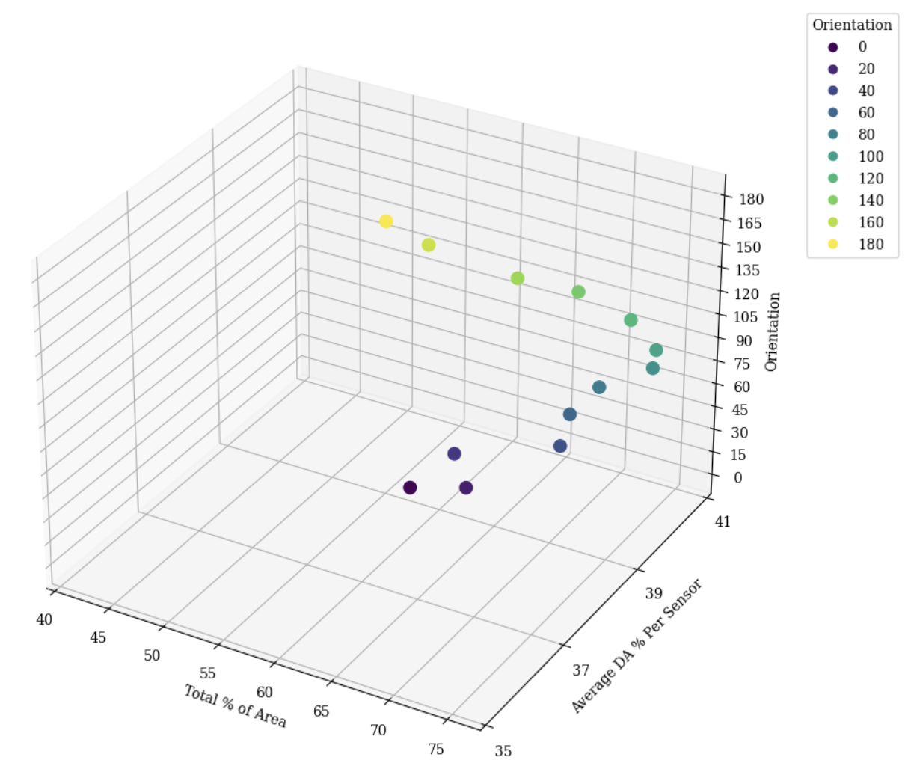
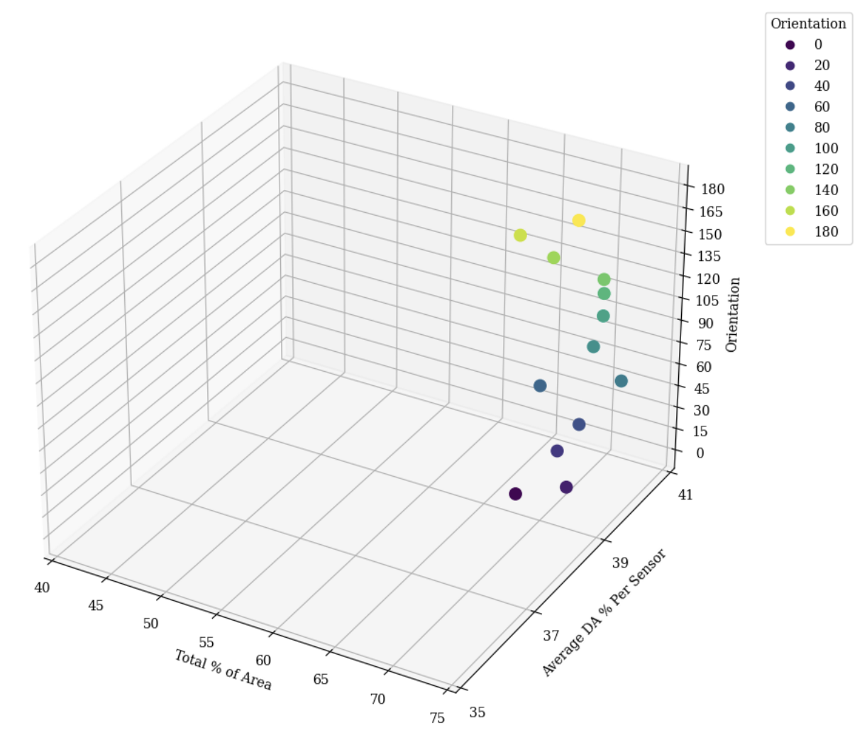
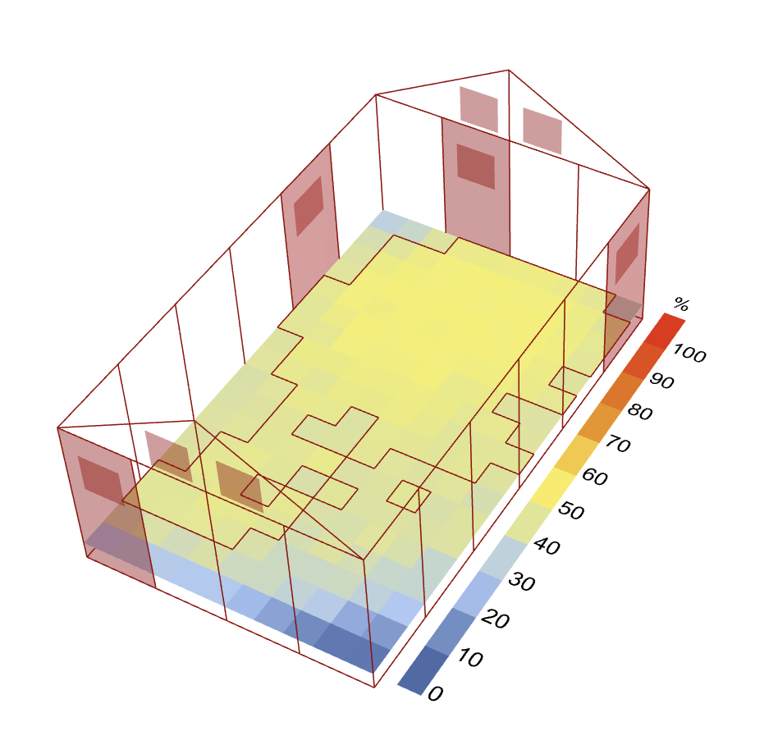
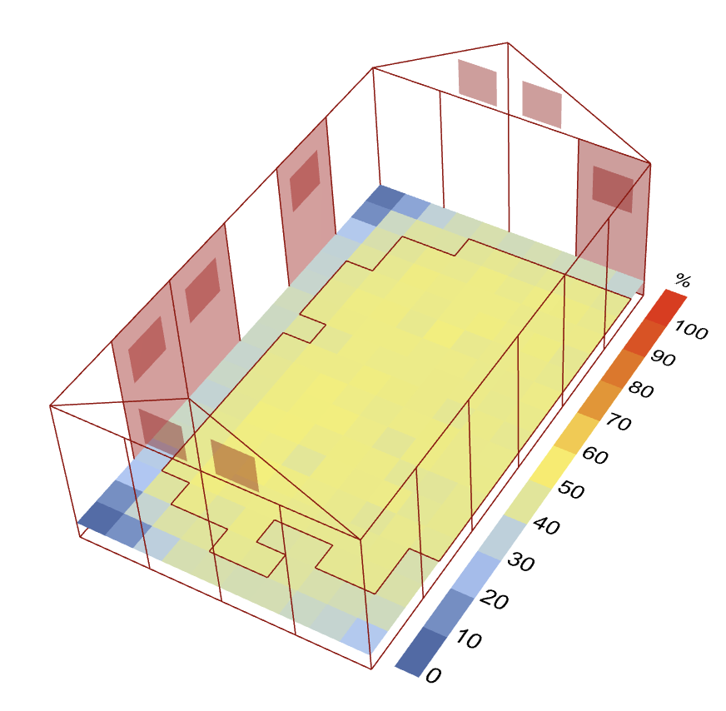
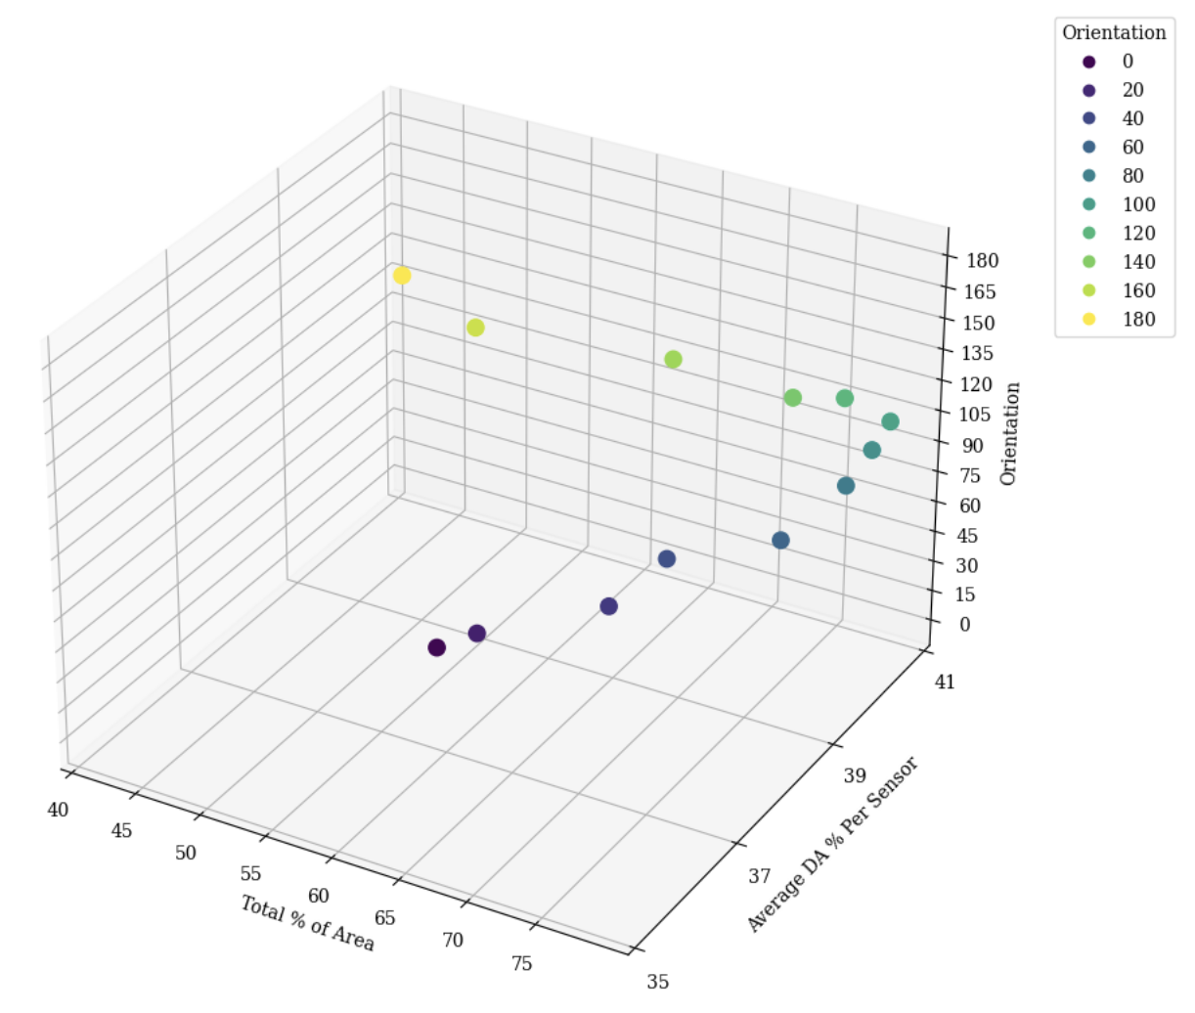
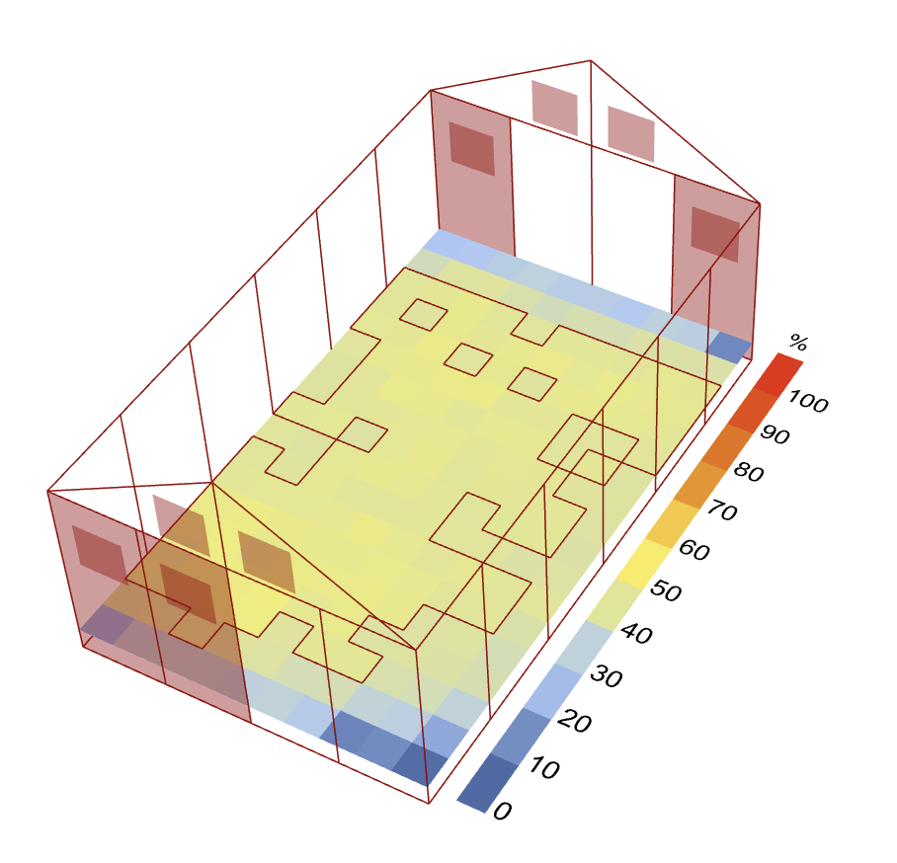
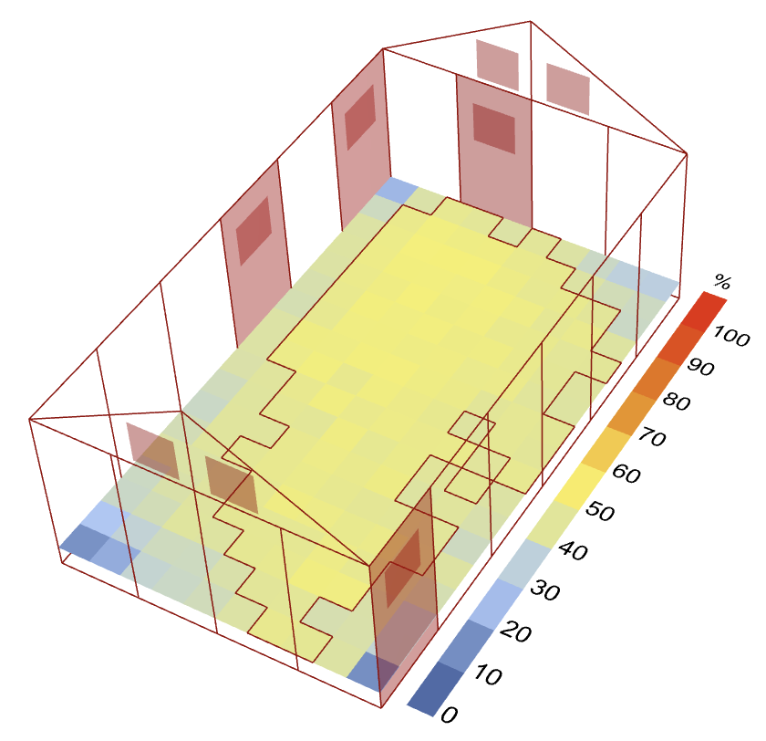
More variable
Number of north/south windows influences orientation effect on performance variability
Less variable

Slide 42
Insights
Window configuration
Orientation
Minimal effect on even distribution/dark corners
Winter sun decreases DA significantly
Windows do not need to be evenly spaced
Unit length is better aligned with east/west windows
Consecutive and corner windows can be effective
Number of north/south windows affect performance variability

Slide 43
Limitations
Lack of expertise
Time constraint
First experiences with daylight analysis and machine learning
Limited data collection
Trial and error takes time

Slide 44
Outlook
More data
Interactive system
For extensive design exploration
Lots of factors compound
User-friendly system for practical use
Can be applied to other types of modular shelters

Slide 45
Significance
Decrease dependence on solar panels
Leverage modularity for future-proof design
Avoid unit disuse through quality control
Improve response to any given emergency
Ensure health, safety, and productivity
Enhance efficiency of daylight analysis tools

Slide 46
Thank you!

Slide 47
References
Better Shelter. (2022). Annual review 2022. Global Compact Communication on Progress. https://bettershelter.org/wp-content/uploads/2023/07/2022_Annual-review-FINAL-for-design-Better_Shelter-078-01-1.pdf
Brownell, E. (2020, April 1). Better Shelter. https://ebrownell.com/wp-content/uploads/2020/04/1.-brownell-better-shelter-proofs-2019.pdf
Cerini, M. (2023, August 31). Home in a box: Rethinking disaster relief, IKEA style. CNN. https://edition.cnn.com/style/better-shelter-home-disaster-ikea-dfi/index.html
Dunn, E. C. (2015, October). Ikea’s Flat-Pack Shelters for Refugees Are Better Than Tents—but Still Worse Than Houses. Slate Magazine. https://slate.com/technology/2015/10/ikea-gives-10000-flat-pack-shelters-for-refugees.html
Dyvik, E. H. (2023, December 11). Major refugee-hosting countries worldwide 2023. Statista. https://www.statista.com/statistics/263423/major-refugee-hosting-countries-worldwide/
Fairs, M. (2017, April 27). IKEA refugee shelter to be redesigned following safety fears and design flaws. Dezeen. https://www.dezeen.com/2017/04/27/ikea-unhcr-refugee-better-shelter-redesign-safety-fears-flaws/
Goyal, B. (2020, August 15). Introduction to GANs - Analytics Vidhya - Medium. Medium; Analytics Vidhya. https://medium.com/analytics-vidhya/introduction-to-gans-38a7a990a538
Housing Innovation Collaborative. (2023, July 26). Better Shelter RHU 1.2. Housing Innovation Collaborative. https://housinginnovation.co/rapidshelter/rhu1-2/
IRC. (2023, June 13). 110 million people displaced around the world: get the facts. IRC. https://www.rescue.org/article/110-million-people-displaced-around-world-get-facts#:~:text=With%20over%20110%20million%20people,the%20country%20that%20resettle%20refugees
Jahre, M., et al. (2018, March 9). Approaches to the design of refugee camps: An empirical study in Kenya, Ethiopia, Greece, and Turkey. Journal of Humanitarian Logistics and Supply Chain Management, 8(3), 323–345. https://doi.org/10.1108//JHLSCM
Johnson, N. (2015). Construction & Architecture News. Architecture & Design. https://www.architectureanddesign.com.au/news/ikea-produces-10-000-flat-pack-shelters-for-un-ref
Kaminska, A. (2020). Impact of Building Orientation on Daylight Availability and Energy Savings Potential in an Academic Classroom. Energies, 13(18), 4916–4916. https://doi.org/10.3390/en13184916
Köppen, W. (1936). Das geographische System der Klimate [The geographic system of climates]. Vol. 1. Berlin: Borntraeger. https://koeppen-geiger.vu-wien.ac.at/pdf/Koppen_1936.pdf

Slide 48
References
Kumar, M. (2023, April 7). Illuminance Levels Indoors: Your Standard Lux Level Chart‍. Prana Air. https://www.pranaair.com/blog/illuminance-levels-indoors-the-standard-lux-levels/
Laylin, T. (2014, March 15). 10 refugee shelters we hate to love. Green Prophet. https://www.greenprophet.com/2014/03/pros-and-cons-10-refugee-shelters/
Munoz, C., Esquivias, P. M., David Moreno Rangel, & Navarro, J. (2014, June). Climate-based daylighting analysis for the effects of location, orientation and obstruction. ResearchGate; SAGE. https://www.researchgate.net/publication/273592036_Climate-based_daylighting_analysis_for_the_effects_of_location_orientation_and_obstruction
Peters, A. (2021, February 10). These quick-build disaster shelters can later become permanent houses. Fast Company. https://www.fastcompany.com/90602483/these-quick-build-disaster-shelters-can-later-become-permanent-houses
Phung, & Rhee. (2019, October 23). A High-Accuracy Model Average Ensemble of Convolutional Neural Networks for Classification of Cloud Image... ResearchGate; MDPI. https://www.researchgate.net/publication/336805909_A_High-Accuracy_Model_Average_Ensemble_of_Convolutional_Neural_Networks_for_Classification_of_Cloud_Image_Patches_on_Small_Datasets
Scott-Smith, T. (2017, December 14). A Slightly Better Shelter? Limn. https://limn.it/articles/a-slightly-better-shelter/
Snow, S. (2013, June 26). A New Ingeniously Designed Shelter For Refugees--Made By Ikea. Fast Company. https://www.fastcompany.com/2682416/a-new-ingeniously-designed-shelter-for-refugees-made-by-ikea
Szondy, D. (2013, July 1). Ikea’s turns its flat-pack philosophy to improving refugee shelters. New Atlas. https://newatlas.com/ikea-refugee-shelter/28105/
Terne, M. (2022, November 28). Where we work. Better Shelter. https://bettershelter.org/where-we-work/
UNHCR. (2015). RHU 1.2. Shelter and Settlement Section. https://www.unhcr.org/sites/default/files/legacy-pdf/5c1127d24.pdf
UNHCR (2023). Refugee Data Finder. https://www.unhcr.org/refugee-statistics/
Wainwright, O. (2017, January 27). Why Ikea’s flatpack refugee shelter won design of the year. The Guardian. https://www.theguardian.com/artanddesign/2017/jan/27/why-ikea-flatpack-refugee-shelter-won-design-of-the-year
Zomorodian, Z., Korsavi, S., & Tahsildoost, M. (2016). The effect of window configuration on daylight performance in classrooms : A field and simulation study The effect of window configuration on daylight performance in classrooms: A field and simulation study. International Journal of Architectural Engineering and Urban Planning, 26(1), 15–24. https://core.ac.uk/download/pdf/228155082.pdf

